Slide 1
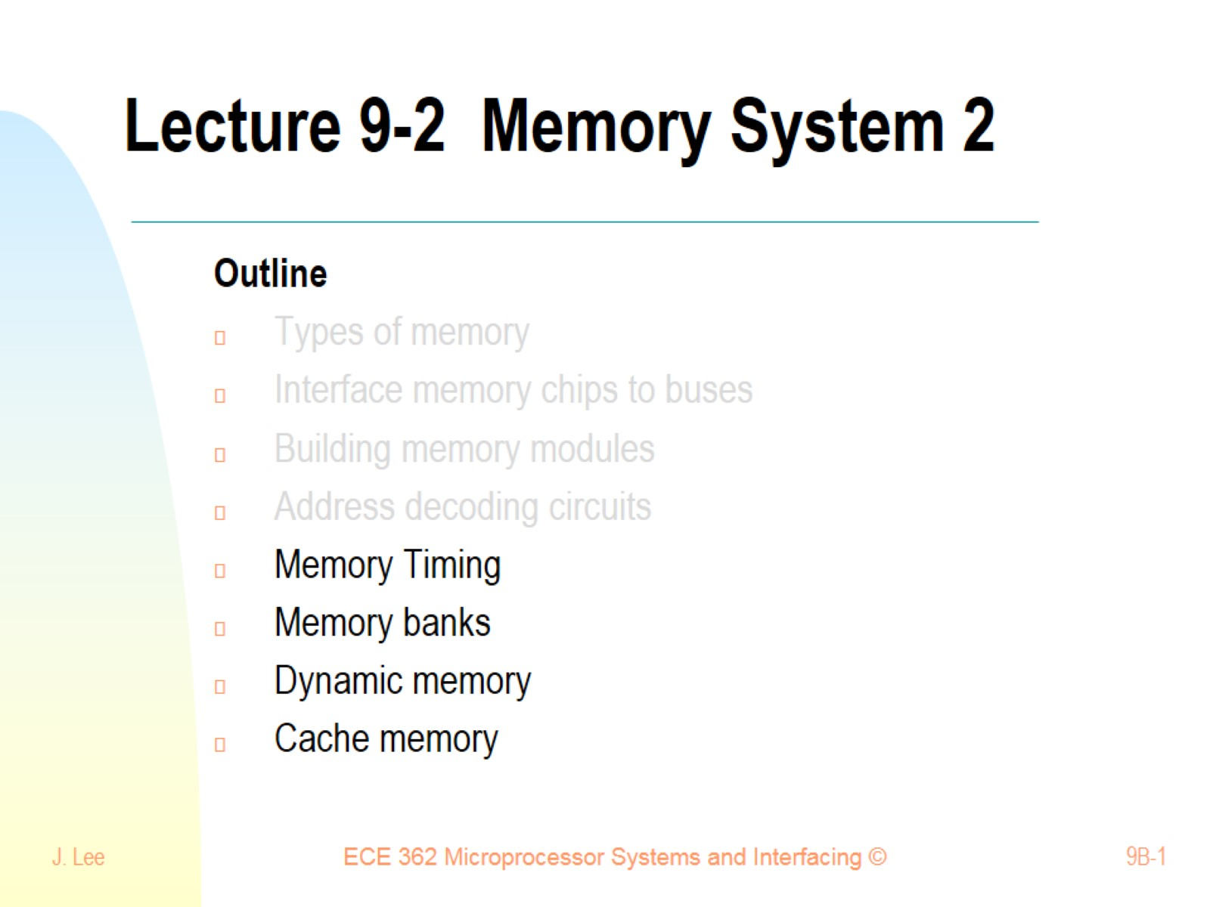
Lecture 9-2 Memory System 2

Slide 2
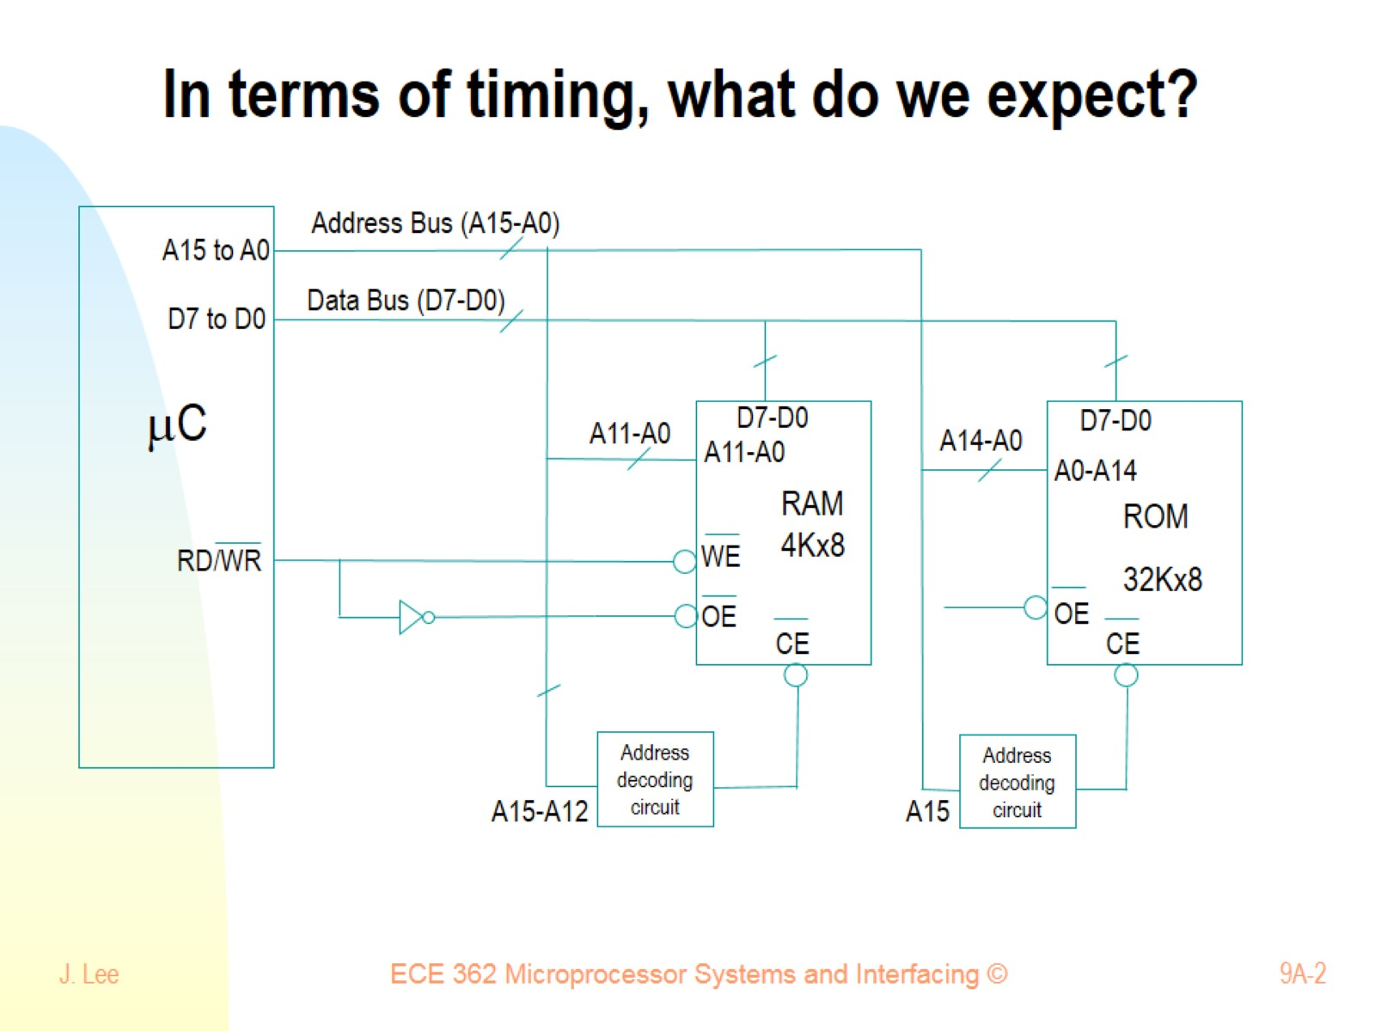
In terms of timing, what do we expect?

Slide 3
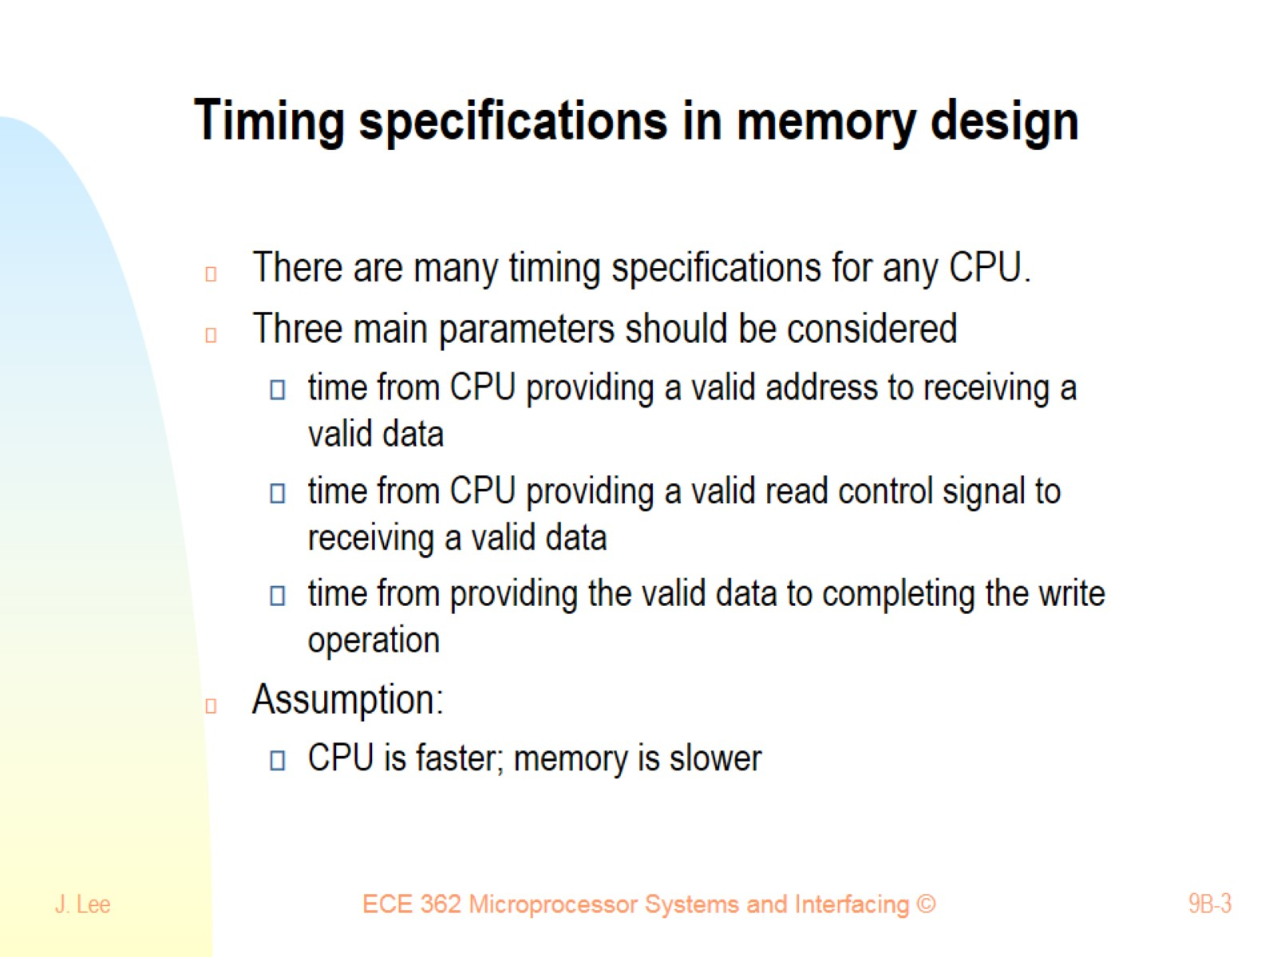
Timing specifications in memory design

Slide 4
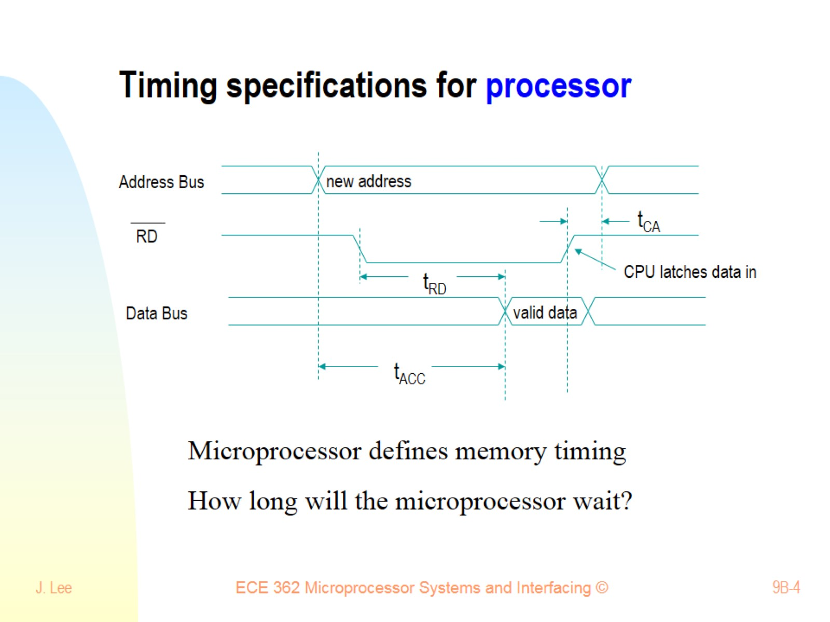
Timing specifications for processor

Slide 5
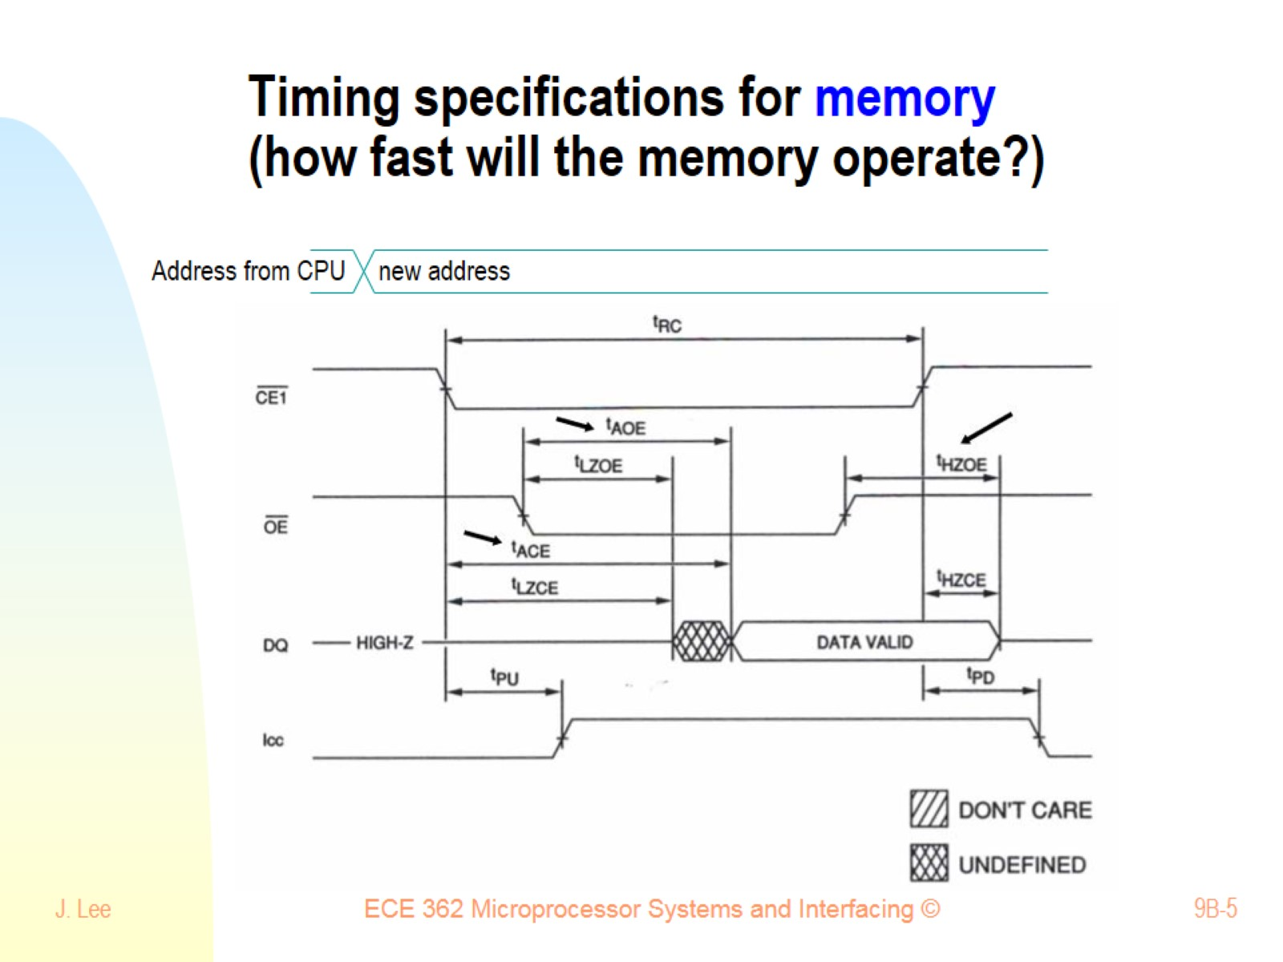
Timing specifications for memory (how fast will the memory operate?)

Slide 6
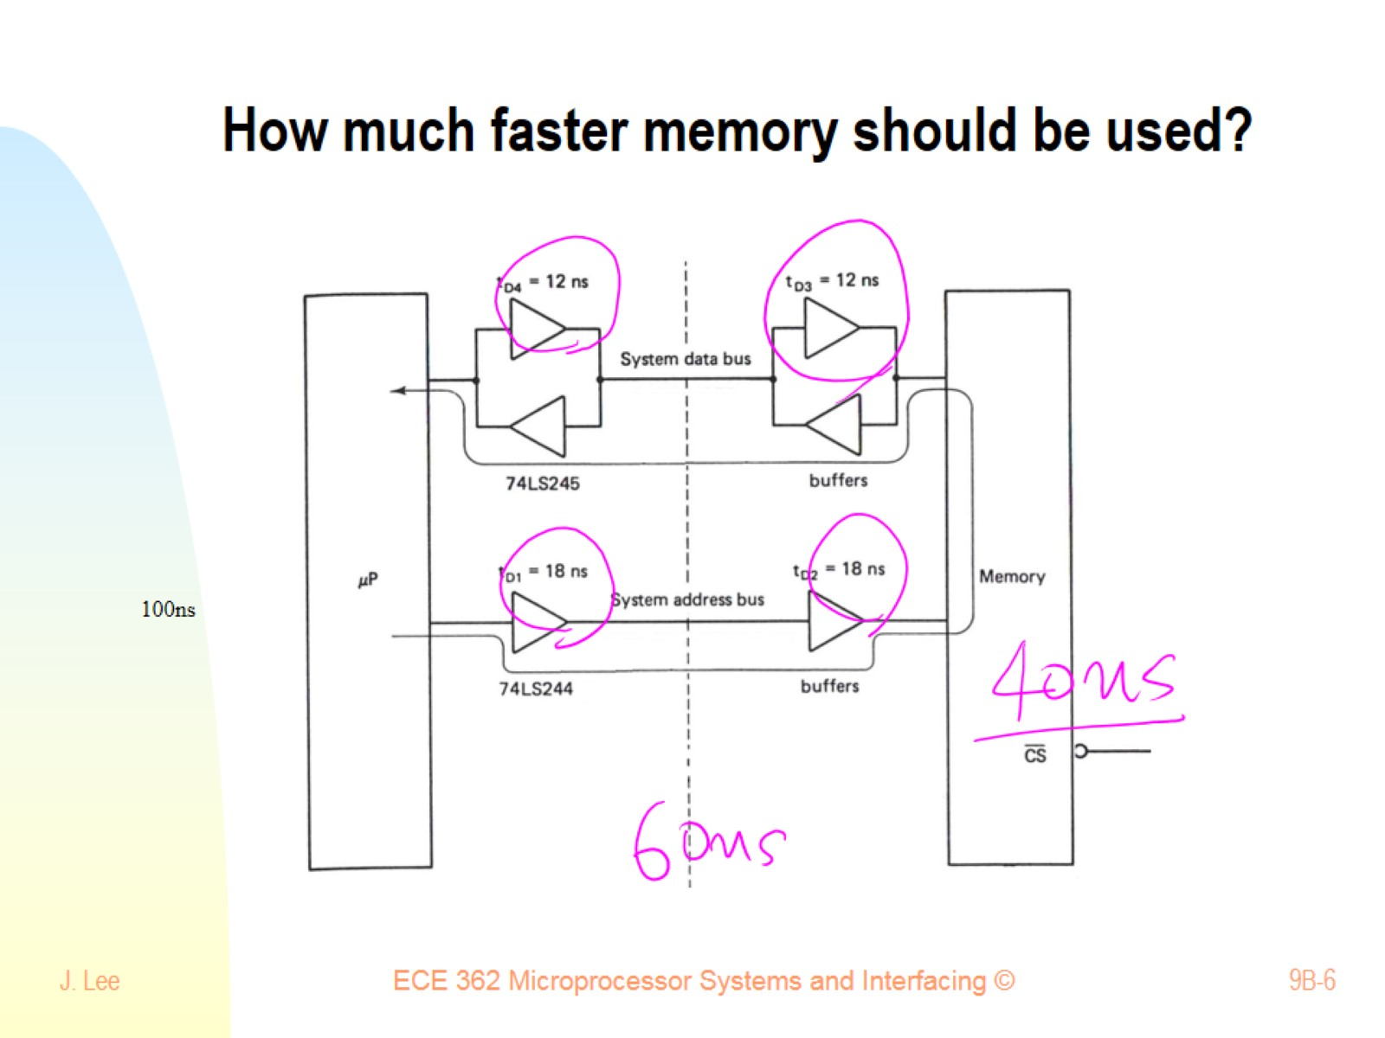
How much faster memory should be used?

Slide 7
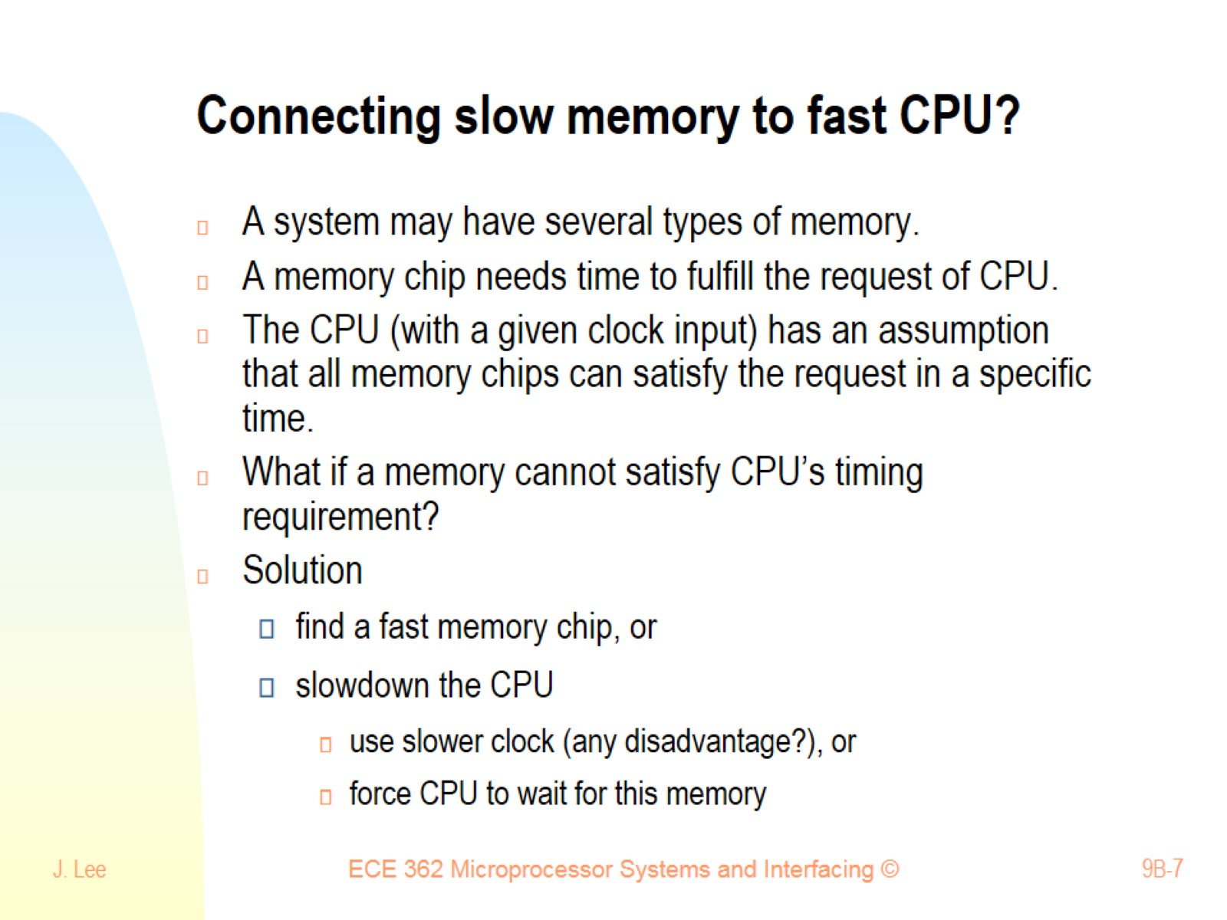
Connecting slow memory to fast CPU?

Slide 8
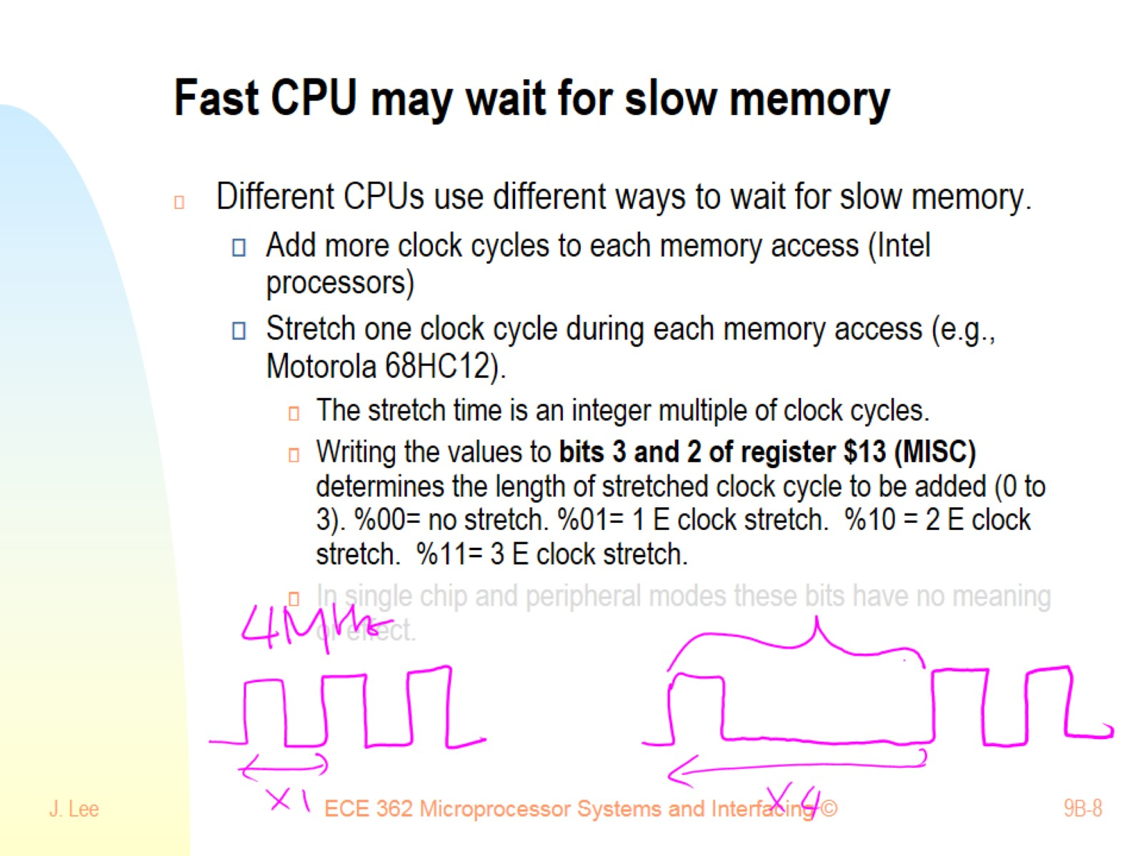
Fast CPU may wait for slow memory

Slide 9
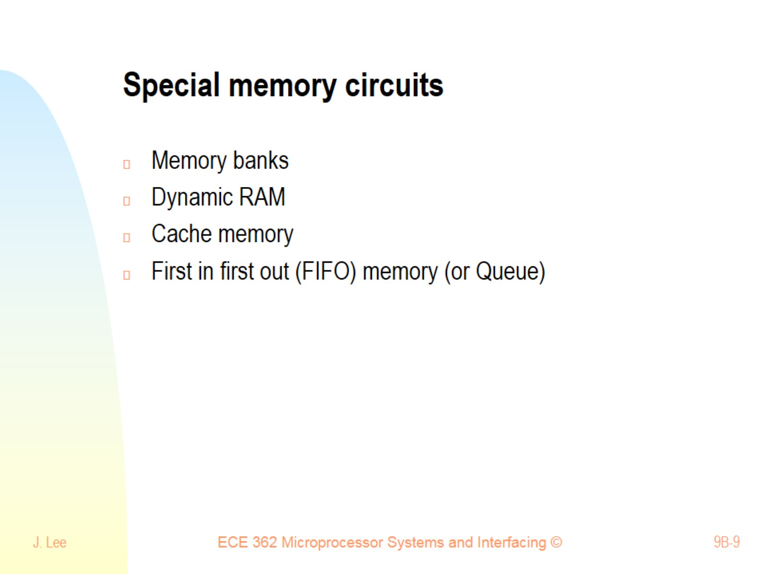
Special memory circuits

Slide 10
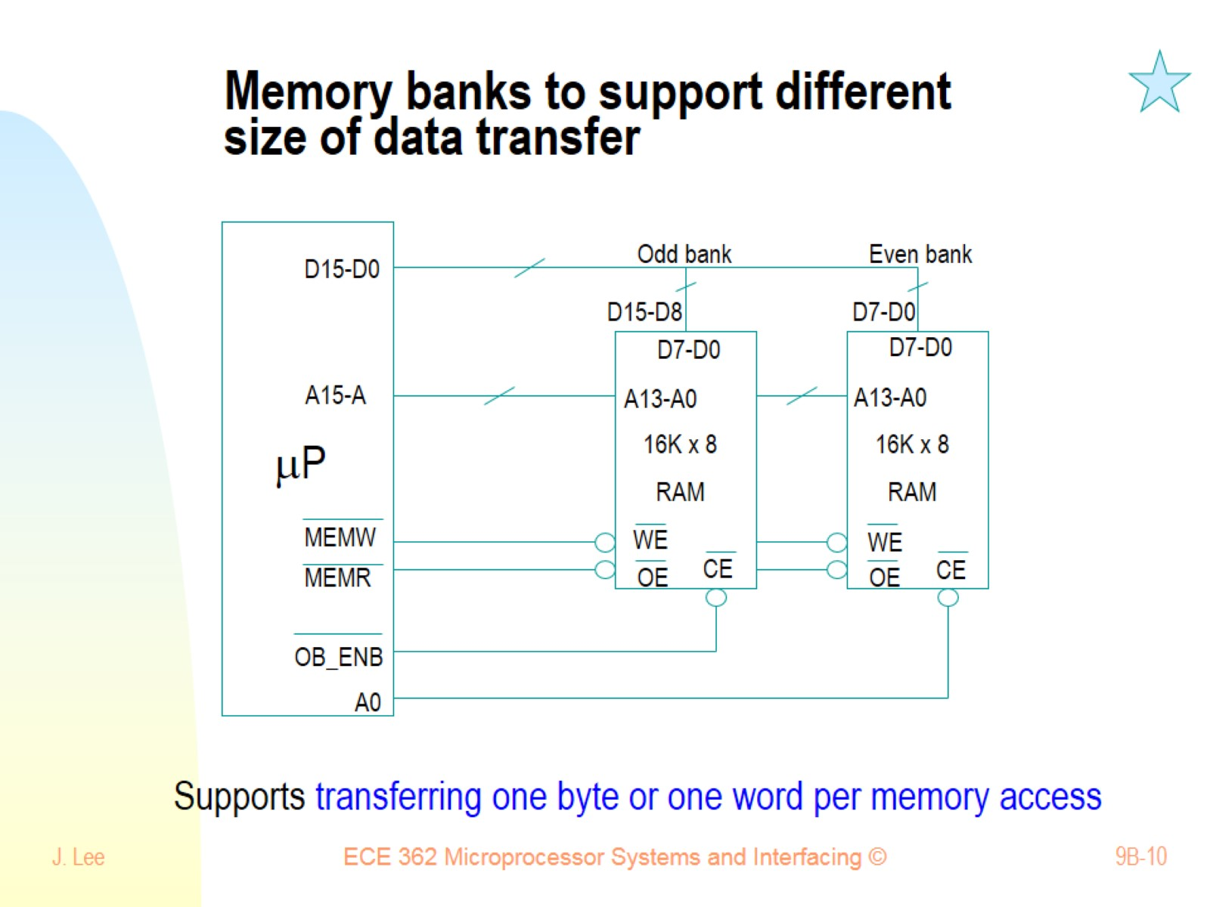
Memory banks to support different size of data transfer

Slide 11
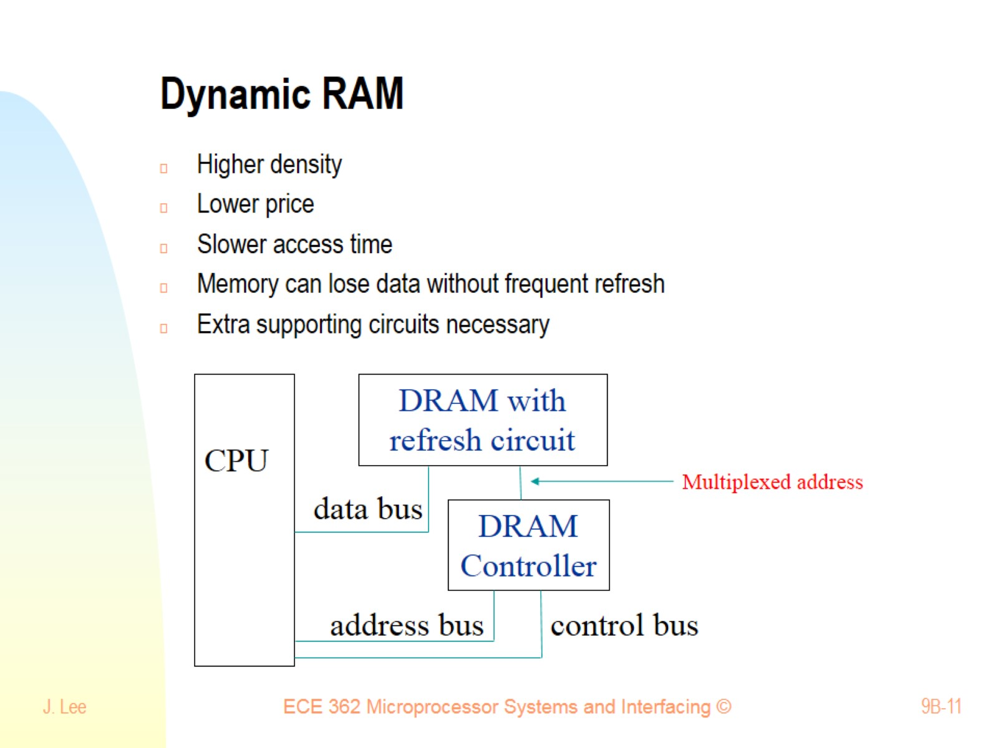
Dynamic RAM

Slide 12
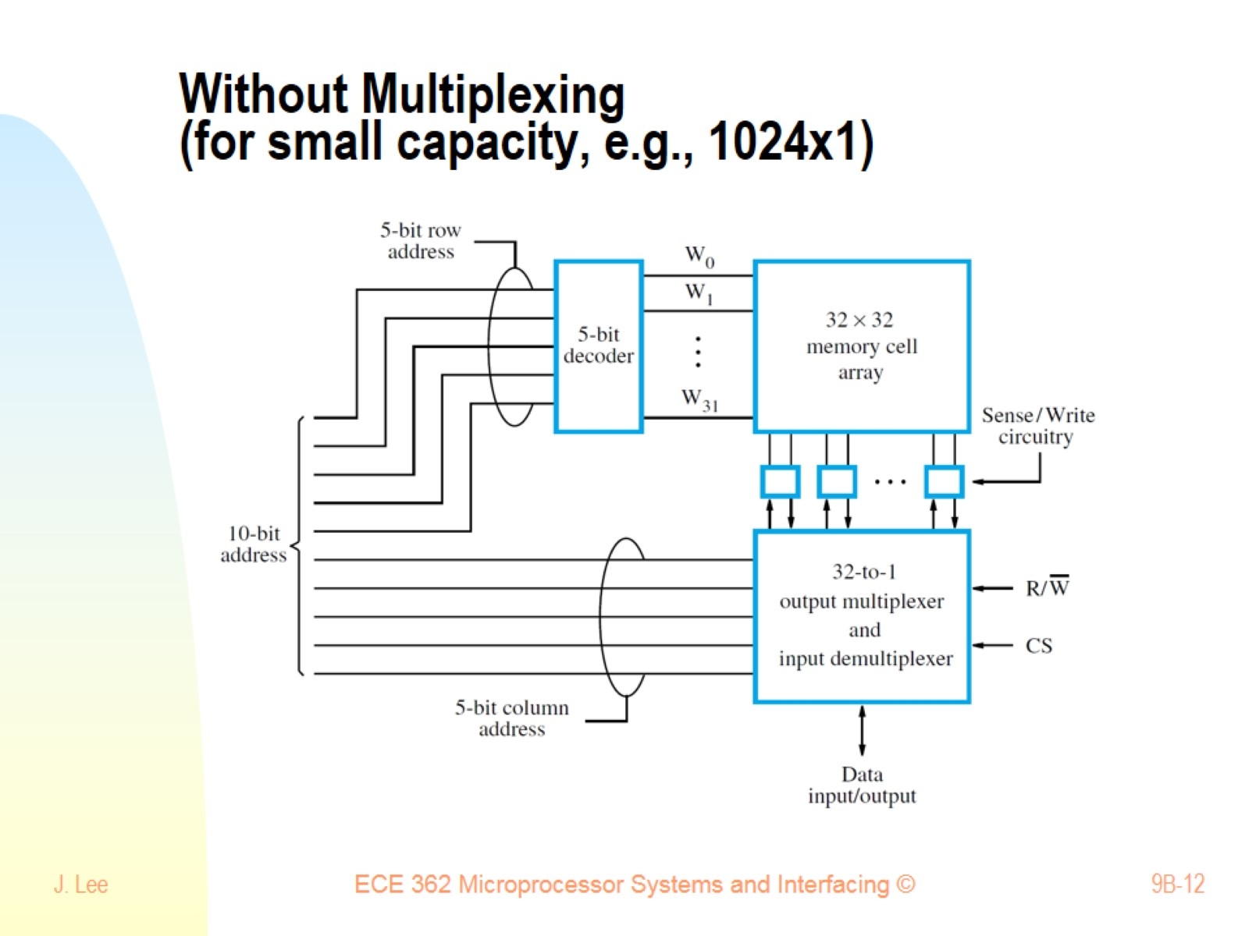
Without Multiplexing (for small capacity, e.g., 1024x1)

Slide 13
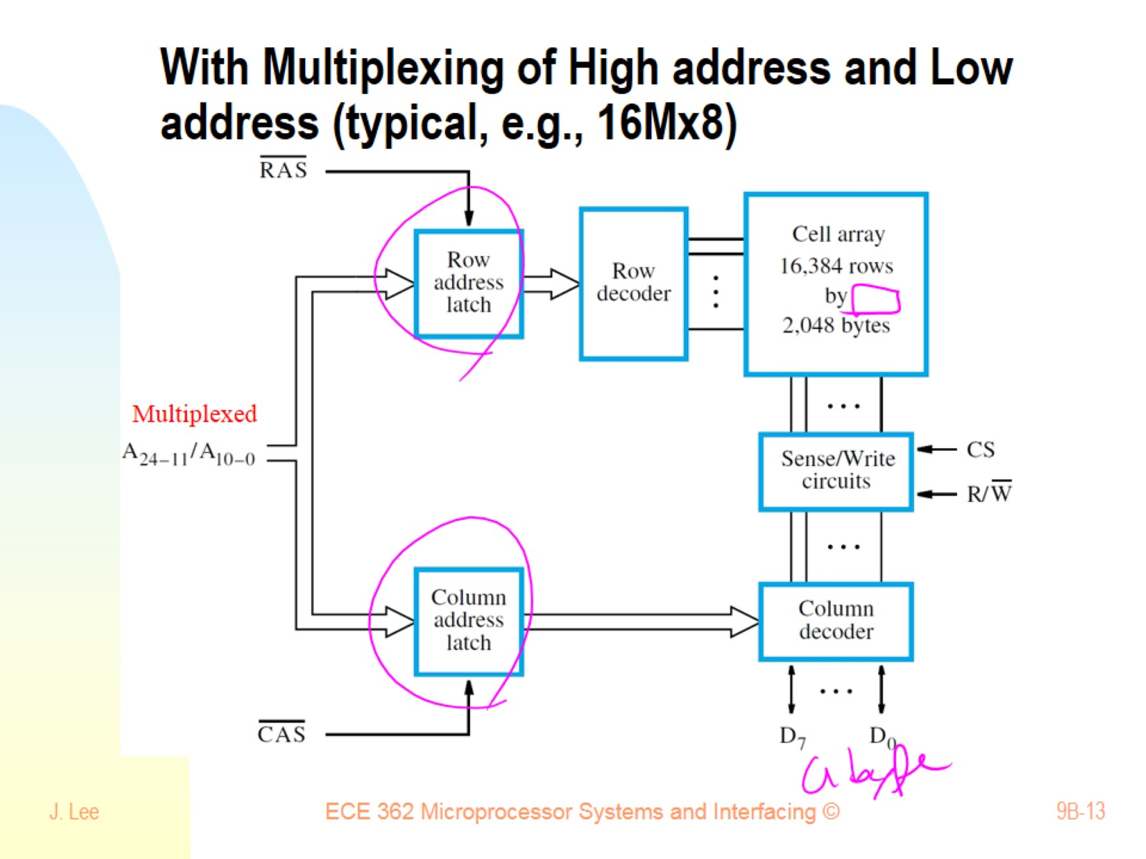
With Multiplexing of High address and Low address (typical, e.g., 16Mx8)

Slide 14
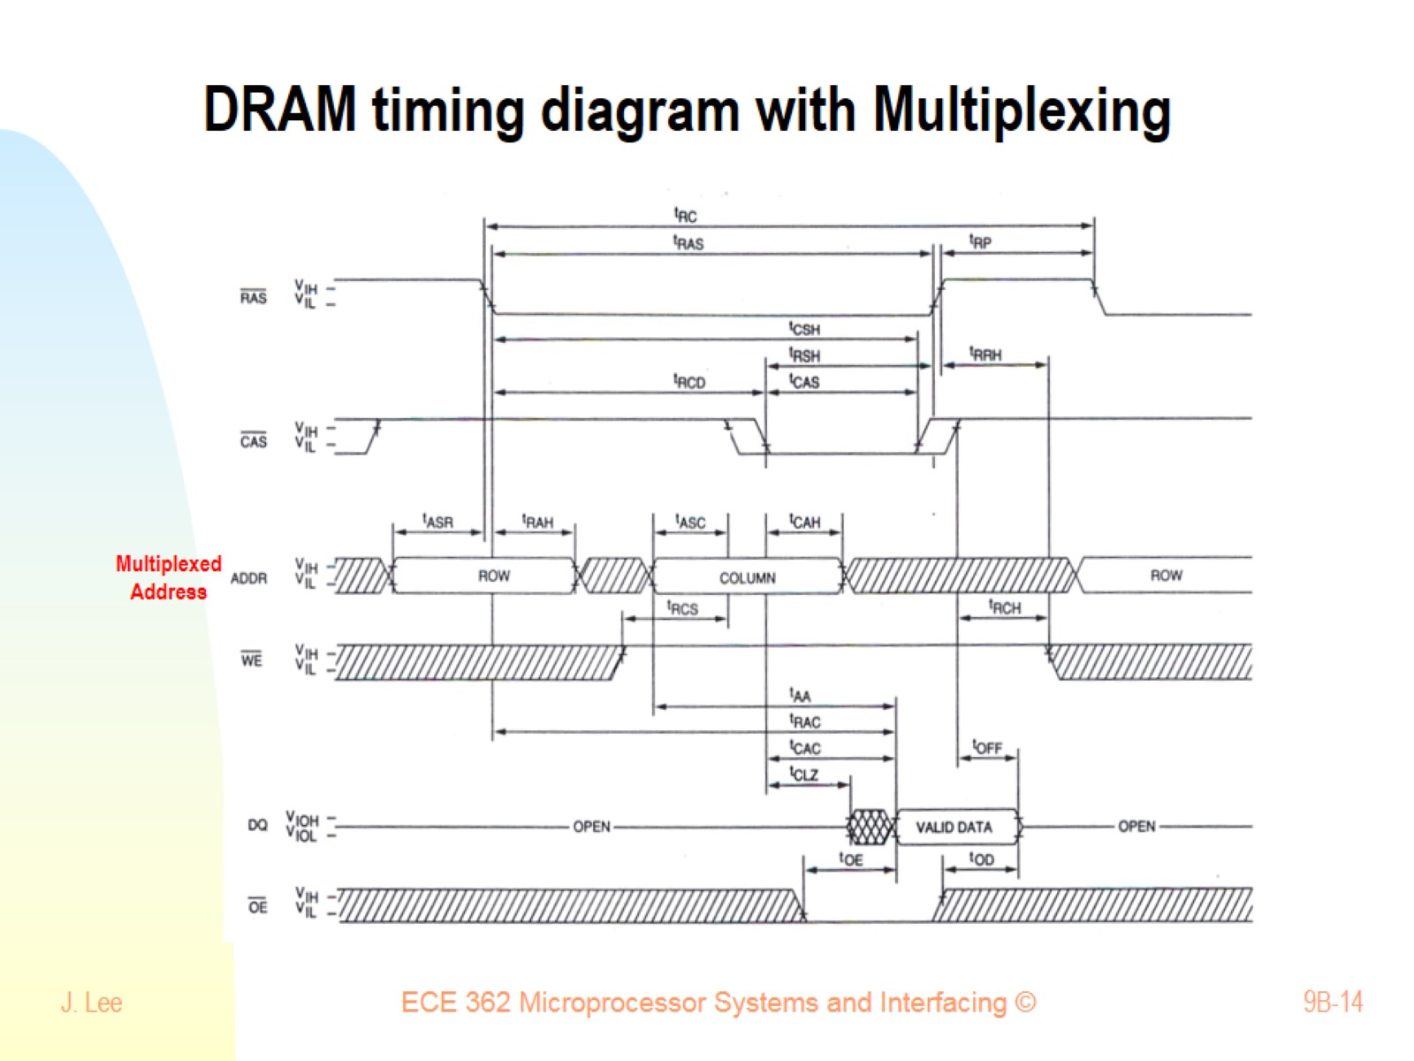
DRAM timing diagram with Multiplexing

Slide 15
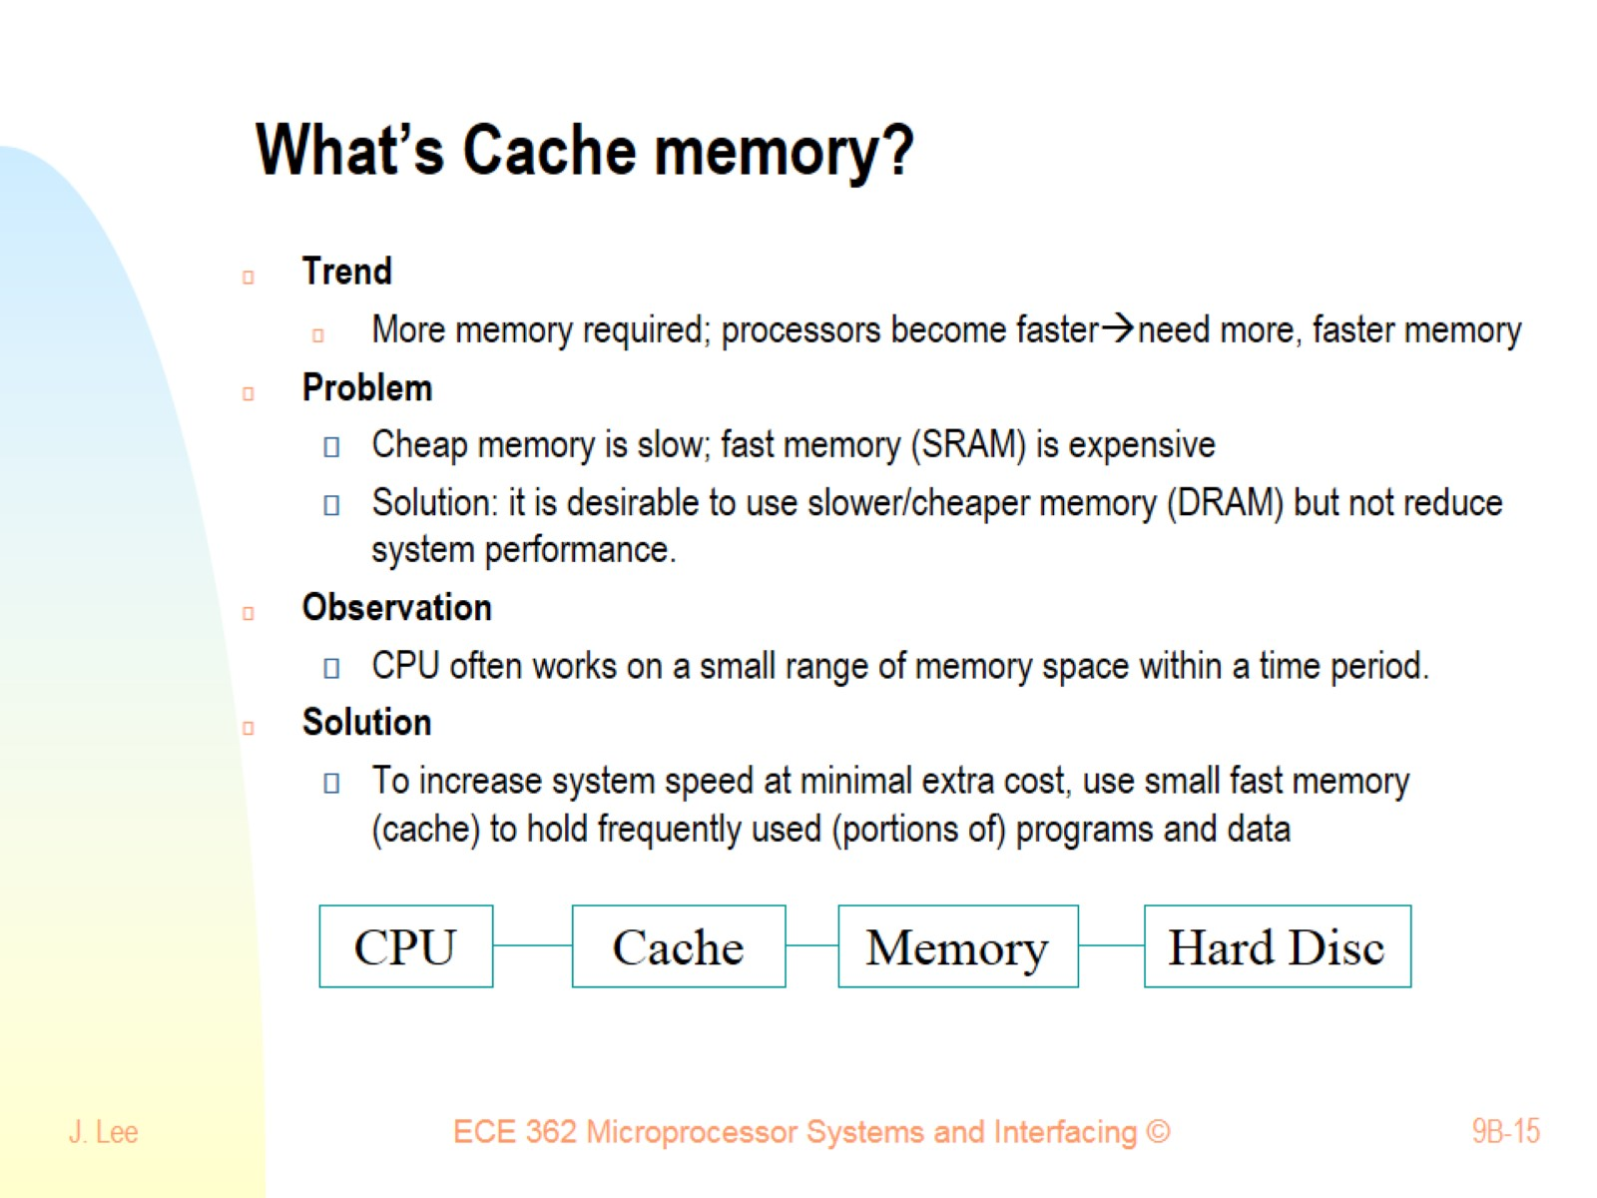
What’s Cache memory?

Slide 16
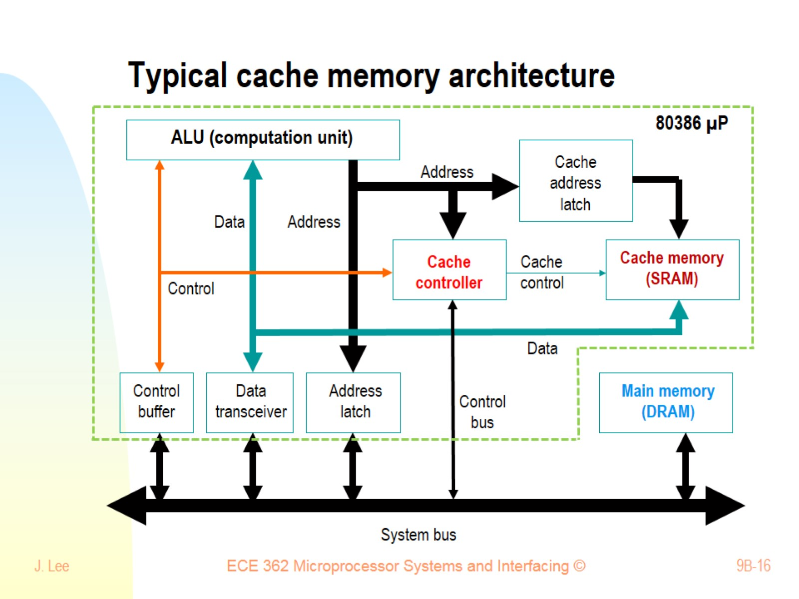
Typical cache memory architecture

Slide 17
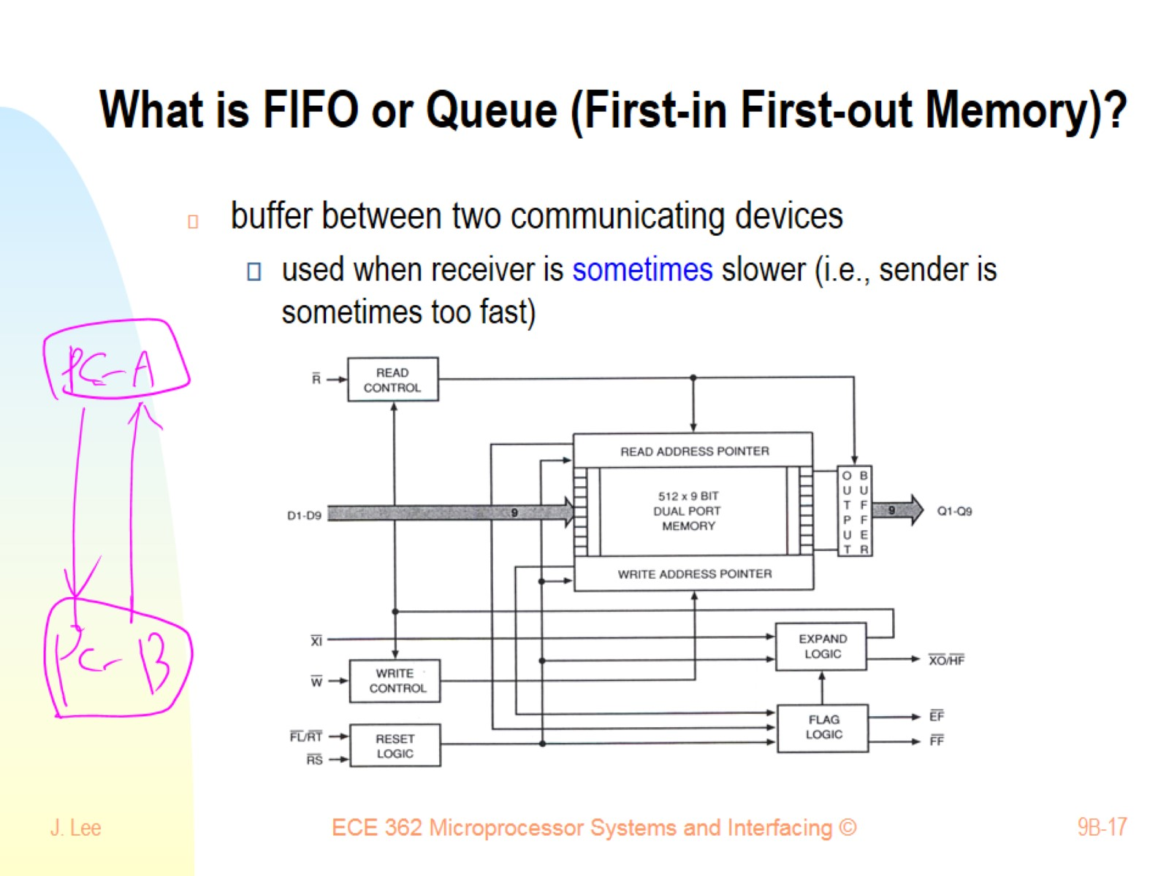
What is FIFO or Queue (First-in First-out Memory)?

